Slide 1


engg 1320 Departmental Project Briefing
Faculty of Engineering, 2023-2024

Slide 2
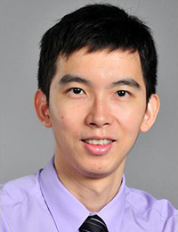

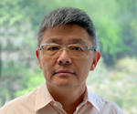
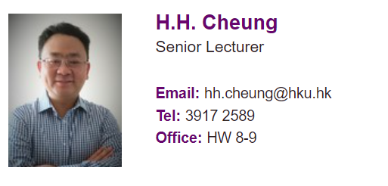

Departmental Representatives for Projects
Associate Professor
Dr. Joseph S.H. CHEUNG
jhcheung@hku.hk
Civil Engineering
Principal Lecturer
Dr. Wilton W. T. Fok
wtfok@eee.hku.hk
Lecturer
Dr. Victor C.S. Lee
csvlee@eee.hku.hk
Electrical and Electronic Engineering
Senior Lecturer
Dr. C.K. Chan
ckchan1@hku.hk
Mechanical Engineering

Slide 3
Project Schedule
6 | 26 Feb(Mon)-C 29 Feb(Thu)-D | Reading week: 04 Mar – 08 Mar. Project supervisors are expected to provide general guidance and supervision on the students’ projects (identification of project objectives and outcomes, technical approach and know-how to be adopted, as well as preparation of reports and oral presentations / roadshows to disseminate the projects) Students are expected to meet project supervisors weekly to report and discuss progress of their projects. Hands-on Project Venue: InnoWing, CYPP2, HW1-5
8 | 11 Mar(Mon)-C 14 Mar(Thu)-D
9 | 18 Mar(Mon)-C 21 Mar(Thu)-D
10 | 25 Mar(Mon)-C 28 Mar(Thu)-D
12 | 08 Apr(Mon)-C 11 Apr(Thu)-D
13 | 15 Apr(Mon)-C 18 Apr(Thu)-D
14 | 22 Apr(Mon)-C 25 Apr(Thu)-D | Students’ group project presentation/demonstration/roadshow/product release…
Class C: 14:30-17:20, Venue: CYPP2 Class D: 13:30-16:20, Venue: CYPP2

Slide 4
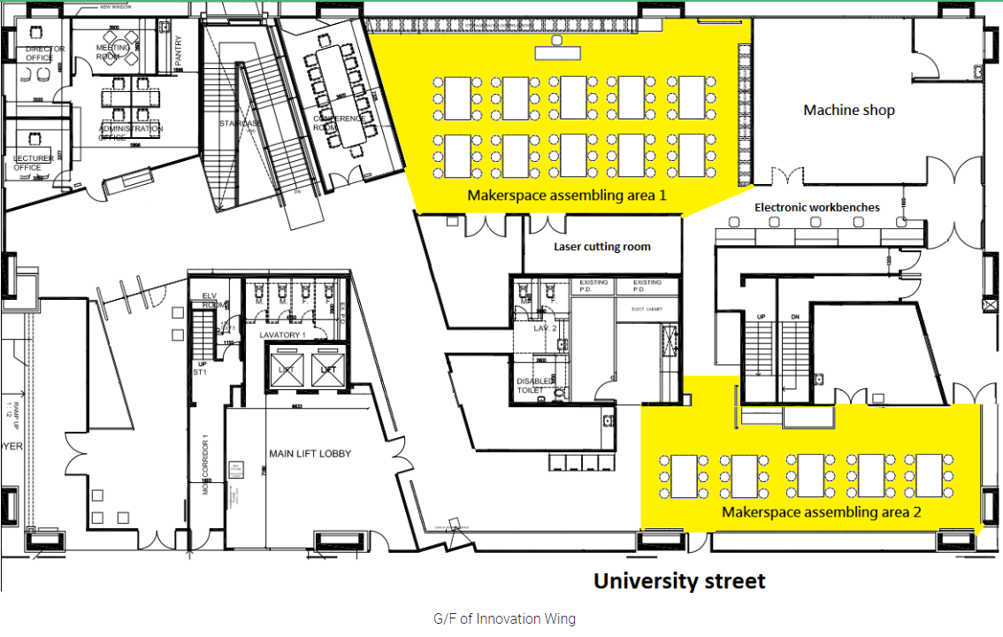
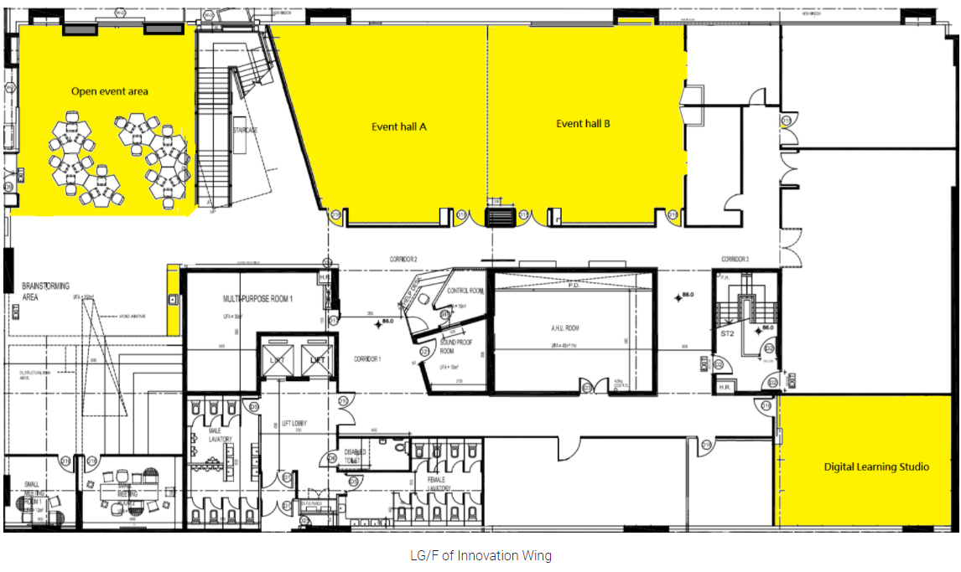
Departmental projects venues
CE group: HW1-5
CS + EEE: CYPP2
IMSE
ME
IMSE

Slide 5
Assessment
Random assessment (5%)
A submission for reporting the project (Each department can decide the form of submission given the characteristics of projects) (85%)
Individual performance based on peer evaluation (10%)

Slide 6
Project Assignment and Grouping
Student enrolment in Moodle
The student grouping will be conducted by each different department.
Each project team has about 5-7 students.
A team coordinator should be elected from each group.

Slide 7
Assessment Criteria from different department
Moodle System
Contact the representatives for assessment details
Students contribution remotely
Tutorials
Peer review

Slide 8
Examples of Peer Review
ENGG1320 Project Peer-assessment Form
Group No.
Your name | Contribution* | Comments, if any
 | 20.0%
 | Contribution * | Comments, if any
 | 20.0%
 | 20.0%
 | 20.0%
 | 20.0%
Total | 100.0%
· Remark: Contribution based on a total of 100%, for example, if all team members have the same contribution, each should get 33.3%.
Departments may use updated peer review form.

Slide 9
Q&A
Thank you!

